Slide 1
Bijou / Al Tahoe Community Plan Amendment Expansion of Special Height Standard to School District Property Applicant: Boys and Girls Club of Lake Tahoe
Advisory Planning Commission
June 10, 2020
AGENDA ITEM V.A
Notes:
Good morning, Mr. Chair and members of the Advisory Planning Commission.
My name is Michael Conger, representing planning staff.
The proposal before you this morning is an amendment to the Bijou / Al Tahoe Community Plan. This is a request by the Boys and Girls Club of Lake Tahoe to apply an existing special height standard to school district property.

Slide 2
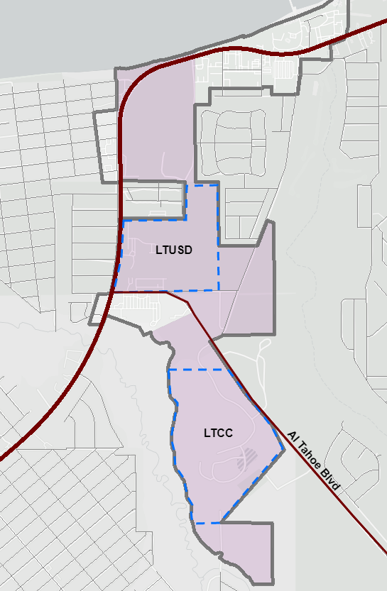
Background
Location
Bijou/Al Tahoe CP
District 4
Public Service Theme
LAKE TAHOE
BATCP District 4 Standards
District 4 Design Standard
Applies District-wide
Required Roof Pitch between 7:12 and 12:12
Special Height Standard
Applies just to Lake Tahoe Community College property
Allows divergence on a case-by-case basis
US Highway 50
Community Plan
District 4
AGENDA ITEM V.A
Notes:
The standard in question affects District 4 of the Bijou Al Tahoe Community Plan in South Lake Tahoe, which is highlighted in purple on the left. This area comprises mostly public facilities, including a recreation center, sheriff’s substation, ice arena, campground, and forest service offices, in addition to the college and junior high school.
There are two standards in District 4 that will be the focus of our discussion. The first is a design standard that applies district-wide, which requires that roof pitches be between 7:12 and 12:12. The second is the special height standard, that allows for height related standards, including the roof pitches, to be determined on a case by case basis. That special height standard applies only to the community college property.

Slide 3
Background
LAKE TAHOE
Applicant
Boys & Girls Club
Currently operates at the old Al Tahoe Elementary School campus
Considering constructing a new building
Objective
Flexibility in building design
Match the design of other public facilities
Allow for a lower roof pitch, consistent with junior high school buildings
Lyons Ave @ Rufus Allen Blvd
US Highway 50
Community Plan
District 4
AGENDA ITEM V.A
Notes:
The Boys and Girls Club of Lake Tahoe has filed this application seeking an amendment to the community plan. The Boys and Girls Club presently operates a facility on the old Al Tahoe Elementary School campus adjacent to the junior high school. Activities are accessory to the school and include such things as after school programs and summer programs for school-age children. The Boys and Girls Club is planning to construct a new building at the eastern end of Lyons Avenue where it meets Rufus Allen Boulevard, adjacent to the building they are currently using. They are seeking an amendment to Bijou / Al Tahoe Community Plan to provide additional flexibility in design. The objective is to allow a lower pitched roof, consistent with other buildings on the school district and community college sites.

Slide 4
Community Plan Amendment
Appendix A, Section 2.B (Height)
District 4 (Public Service Theme)
Special Height Standard
Applicant’s Request:
Expand the special height standard to include school district property
Additional Modifications:
Update chapter numbers
Chapter 22 (Height) → Chapter 37
Chapter 15 (Redevelopment) – deleted in 2012
Lake Tahoe Community College and Lake Tahoe Unified School District propertyies:
Height issues for theise sites shall be addressed by TRPA on an individual project basis, and may be in excess of Chapter 37 (former Chapter 22 & 15) based on project setback, visibility, or other design criteria.
AGENDA ITEM V.A
Notes:
The Community Plan amendment proposal would modify the existing special height standard by changing its applicability. Instead of applying only to community college property, the revised standard would apply to both community college and school district properties. This would allow more flexibility for development on the school district property, as height-related standards like the roof pitch can be determined on a case-by-case basis. As part of this modification, staff is also recommending updating the TRPA code of ordinance chapter references in this section to reflect the renumbering that took place in 2011.

Slide 5
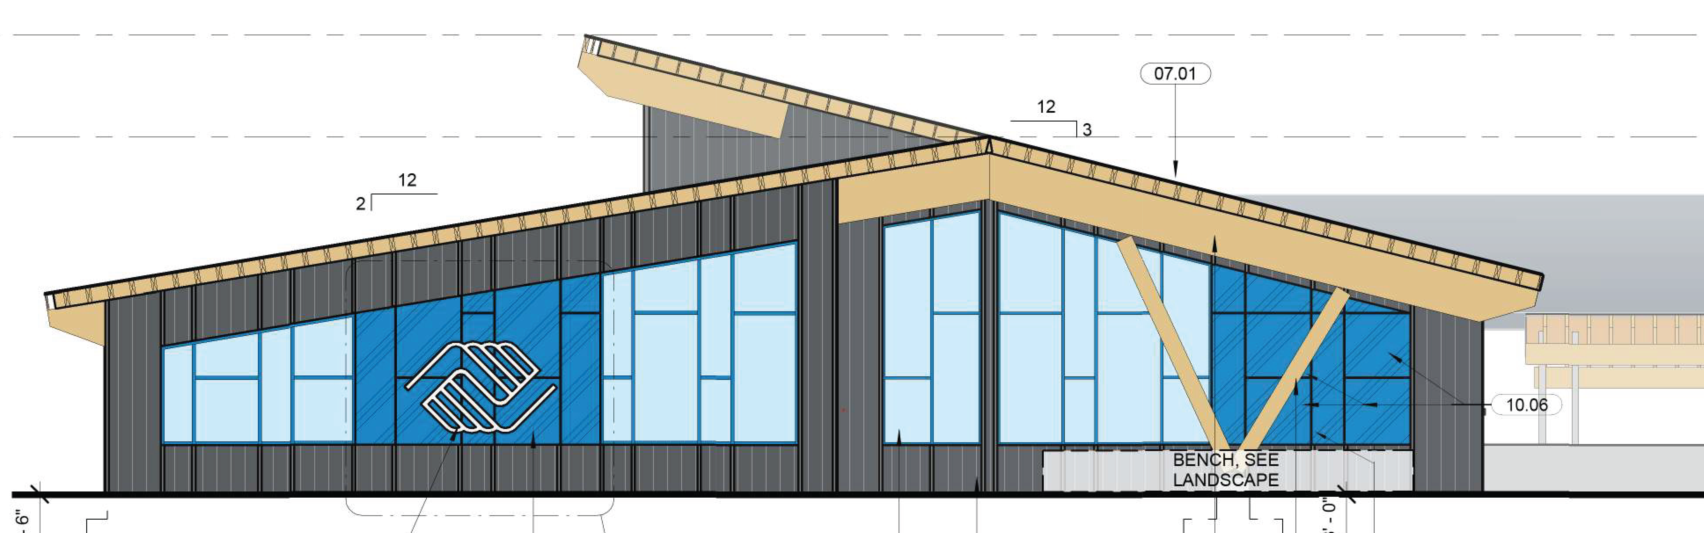
Design Concept Features
Clerestory windows for interior solar access
Roof pitches similar to existing JHS and CC buildings
Community Plan
Roof Pitch
Minimum 7:12
Maximum 12:12
Design Flexibility Sought
Lower roof pitches
Benefits
Reduced height Scenic benefit
Reduced volume Energy efficiency
12:12
7:12
2
3:12
1
2:12
West Elevation
Notes:
This is an image of the western elevation, most visible from Lyons Avenue. The blue lines show conceptual roof lines, while the purple dashed lines show the allowable 7:12 roof pitch. Boys and Girls Club has provided a rationale for this design concept, which is included Attachment F in the staff report. The applicant points out that the flexibility in roof pitch would allow for a lower profile building with less interior volume.

Slide 6
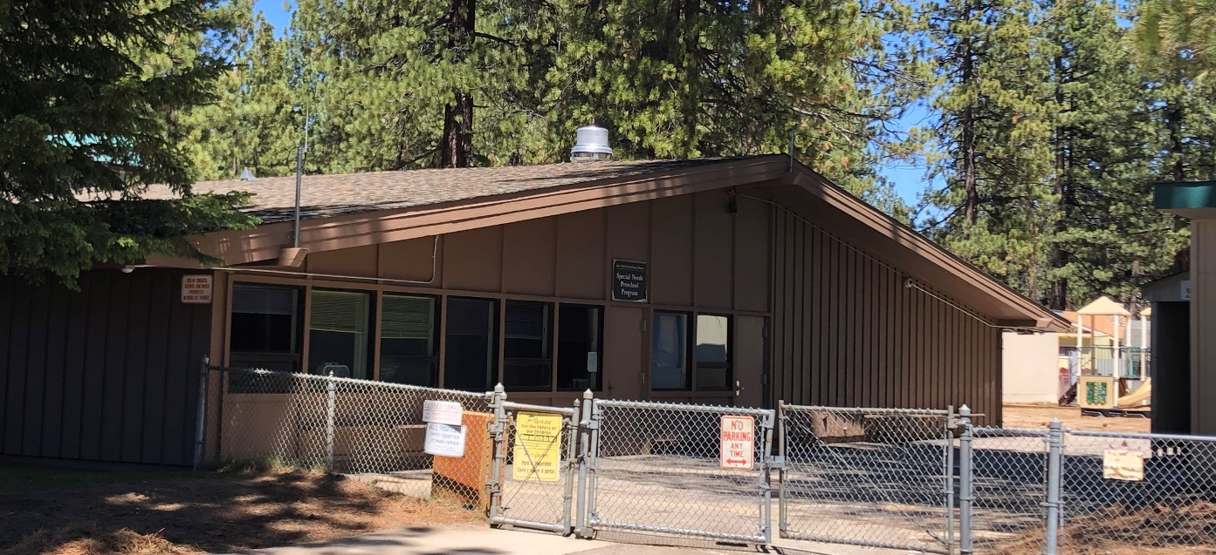
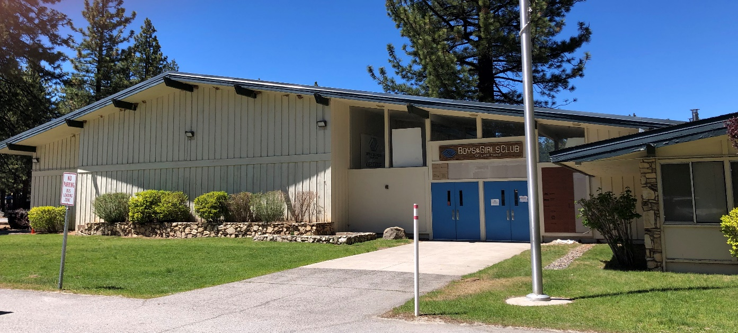
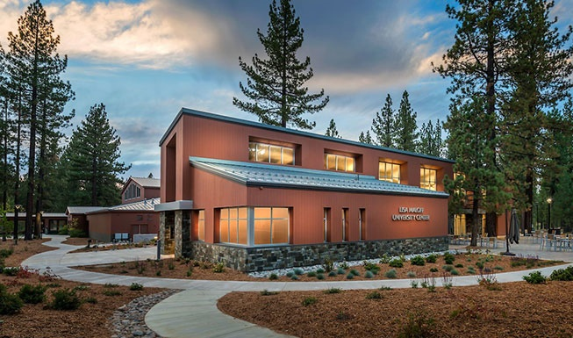
Design in Context
Old Al Tahoe Elementary School
South Tahoe Middle School
Current Boys & Girls Club
LTCC Lisa Maloff Center
Credit: tahoesouth.com
Notes:
This slide shows that design proposal in context with other structures on the community college and school district campuses. The proposed design concept is largely consistent with the design of these structures.

Slide 7
Environmental / Threshold Review
Public Service Uses
Additional Height Findings
Up to 4 feet
Not extend above tree canopy
Designed to minimize interference with views
Up to 14 feet
Height needed for building function
No more than 2 stories
Projects benefitting from the amendment must still go through TRPA permitting
Compliance with citywide design guidelines & standards still required
Findings needed to approve additional height ensure scenic impacts of structures will be les-than significant
IEC concludes no significant impact
Applicant believes amendment will benefit thresholds
Steep roof pitch → taller building, more volume
AGENDA ITEM V.A
Notes:
An Initial Environmental Checklist and a checklist for threshold standards and compliance measures are attached in the staff report. The IEC concludes that the proposal will not result in significant impacts. Scenic impacts, for examples, are not anticipated, because buildings benefitting from the modification will still need to meet citywide design standards and guidelines. Additionally, TRPA would need to make scenic-related findings for any building seeking additional height beyond the standard code allowance. As illustrated in the previous slide, the applicant has noted that strict adherence to roof pitch standard would have necessitated a taller building with significantly more interior volume. By allowing flexibility, the building would be less visible and more energy efficient than what would otherwise have been allowed.

Slide 8
Recommendation
Recommend that the Governing Board:
Adopt the Findings (Attachment B)
Including a finding of no significant effect
Adopt the Ordinance (Attachment A)
Modifying the Bijou / Al Tahoe Community Plan by expanding the special height standard
AGENDA ITEM V.A
Notes:
Based on this analysis, staff recommends that the Advisory Planning Commission recommend Governing Board adoption of the findings in Attachment B and the ordinance in Attachment A.
This concludes staff’s presentation; I’m available for any questions your commission might have. Thanks.

Slide 9
Advisory Planning Commission Questions
AGENDA ITEM V.A

Slide 10
Public Comment
AGENDA ITEM V.A

Slide 11
Advisory Planning Commission Deliberation and Action
AGENDA ITEM V.A

Slide 12
Required Motions
A motion to recommend approval of the Required Findings as described in Attachment B, including a Finding of No Significant Effect, for adoption of the Community Plan amendment as described in the staff summary; and
A motion to recommend adoption of Ordinance 2020-___, amending Ordinance 2019-03, as previously amended, to amend the Bijou / Al Tahoe Community Plan as shown in Attachment A.
AGENDA ITEM V.A

Slide 14
AGENDA ITEM V.A

Slide 15
AGENDA ITEM V.A

Slide 16
Rufus Allen Blvd
Lyons Ave
LTUSD
US Hwy 50
District 3 LTUSD
Al Tahoe Blvd
AGENDA ITEM V.A

Slide 17
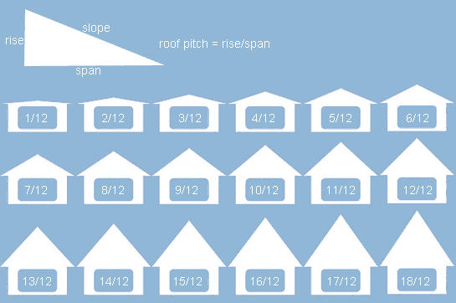
Proposed
CP Design Standard
7:12
3:12
2:12
West (Lyons Ave)
South
North
East
AGENDA ITEM V.A

Slide 18
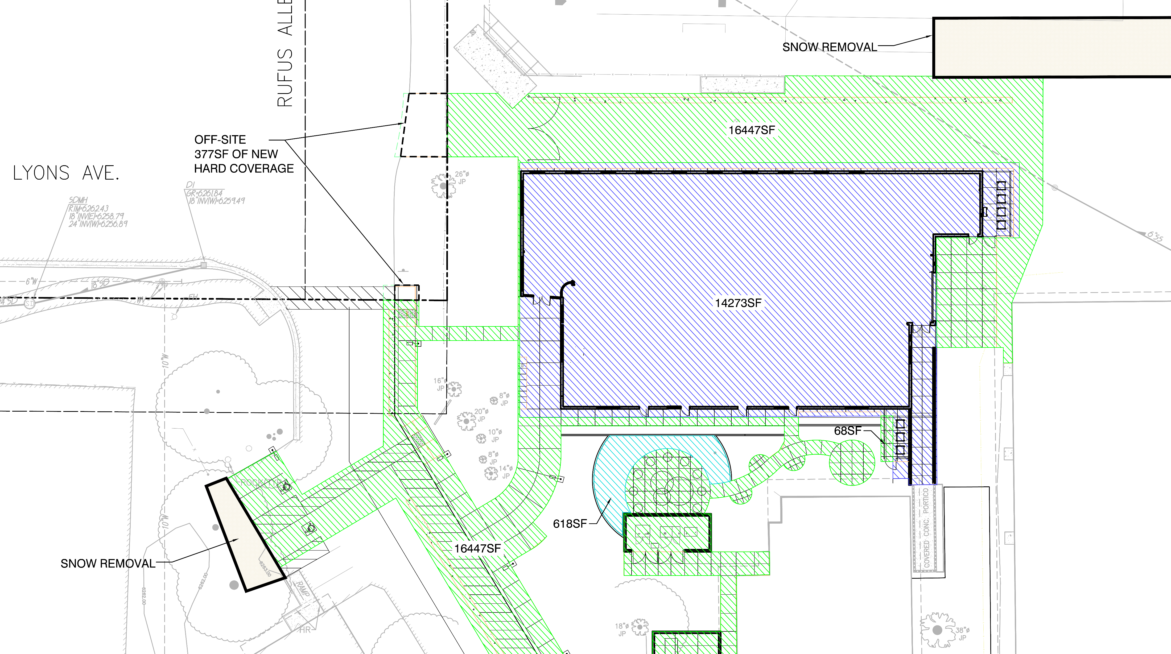
AGENDA ITEM V.A

